Slide 1
Selection and Presentation Practices for Code Example Summarization
Annie T. T. Ying and Martin P. Robillard
School of Computer Science
McGill University, Montréal, Canada
{annie.ying,martin}@cs.mcgill.ca ACM November 16–22, 2014 Presentation by - Chirag Chudasama (cbc140130)

Slide 2
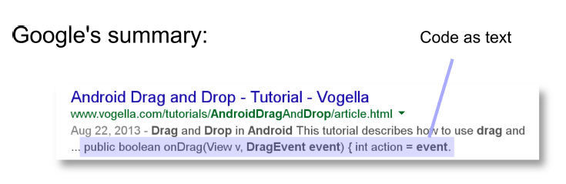
What is Code Example Summarization?
Snippet of Code
Helps Developers identify previously known idioms
Longer code example difficult to understand

Slide 3
Related Work
Studies on Code Example
Source Code Explanation
Snippet Generation in Search Engine

Slide 4
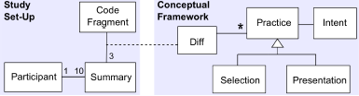
Study Setup
Selection
Presentation

Slide 5
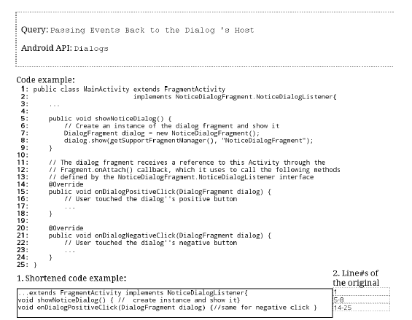
Interface for the Participants

Slide 6
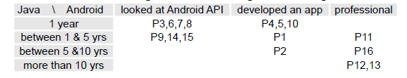
Participants Development Experience

Slide 7
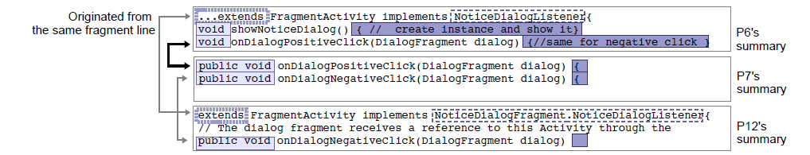
Conceptual Framework

Slide 8
Selection Practices
Practices related to Language Constructs
Practices based on Query Terms
Practices considering the Human Reader

Slide 9
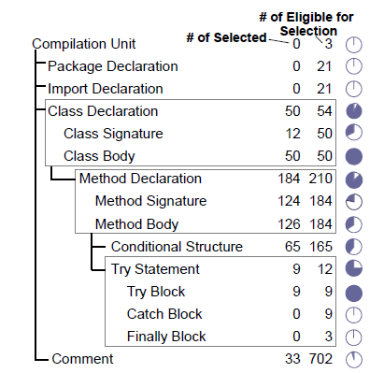
Selection Practices: Practices related to Language Constructs
Including (or Excluding) the Method Signature
Including Overriding Methods
Excluding Exception Handling Blocks
Keeping only One Case in a Parallel Structure

Slide 10
Selection Practices: Practices based on Query Terms
Used terms from Query
13/16 participants found it significant

Slide 11
Selection Practices: Practices considering the Human Reader
Including Easy-to-Miss code
Accounting for Programming Expertise
Using the Query to Infer Expertise

Slide 12
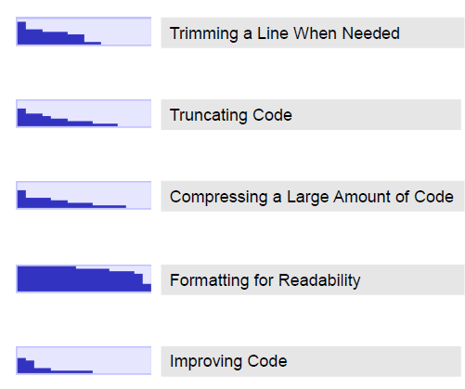
Presentation Practices
Trimming a Line When Needed
Compressing a Larger Amount of Code
Truncating Code
Formatting Code for Readability
Improving Code

Slide 13
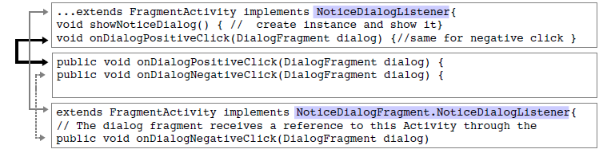
Presentation Practices: Trimming a Line When Needed
Shortening Identifiers
Shortening API Names
Eliding Type Information

Slide 14
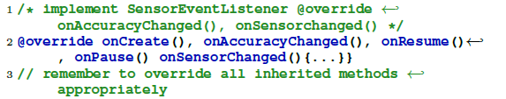

Presentation Practices: Compressing a Larger Amount of Code
Shortening Multiple Statements
Shortening Method Declarations
Shortening Control Structures

Slide 15
Presentation Practices: Truncating Code
Eliminating a Parameter
Truncating a Signature

Slide 16

Presentation Practices: Formatting Code for Readability
Indenting Code
Treating lines as separate

Slide 17

Presentation Practices: Improving Code
Refactoring
Generalization
Clarification

Slide 18
Conclusion
Existing usage of Code and Query terms
Importance of Human Reader
No copy/paste
Compilable, Readable, Understandable

Slide 19
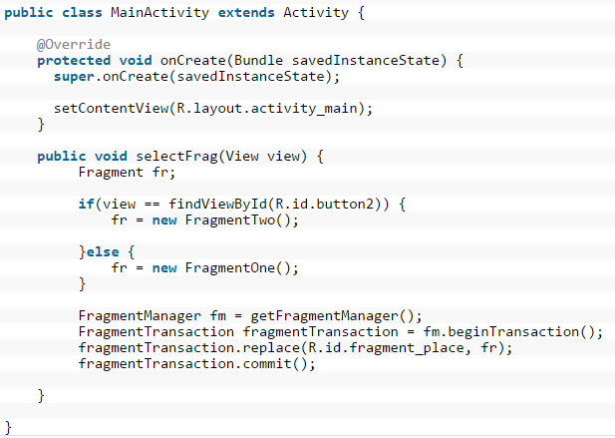
Question 1: Provide Code Summary

Slide 20
Questions
2) What do you mean by Selection Practices and Presentation Practices?
3) Do you feel indenting the code is important?

Slide 21


